Slide 1
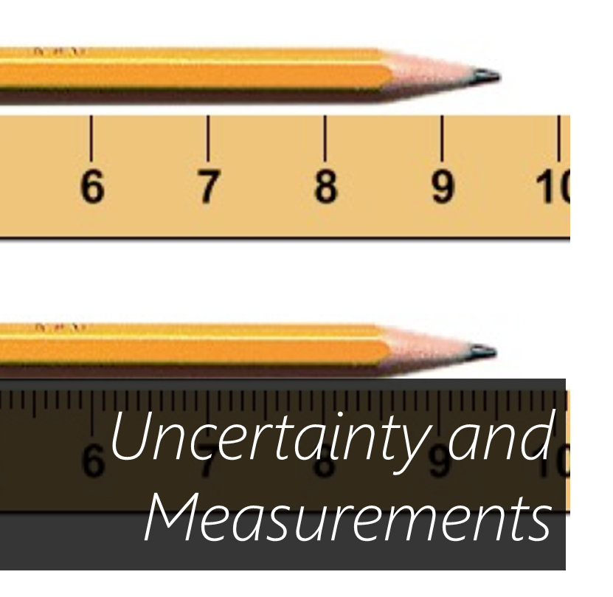
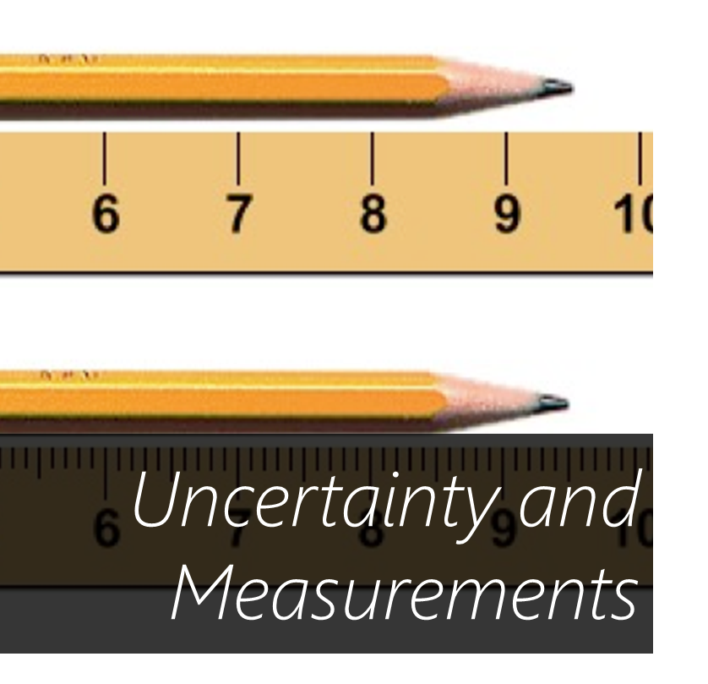




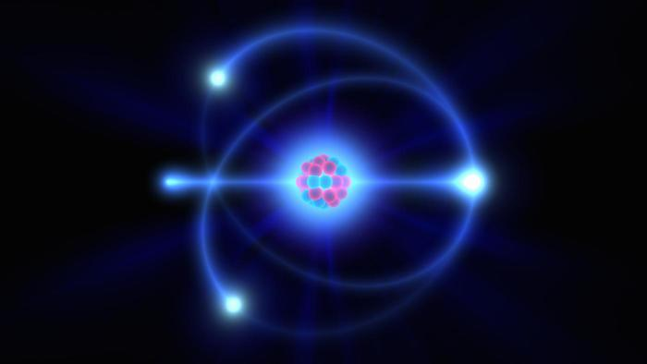
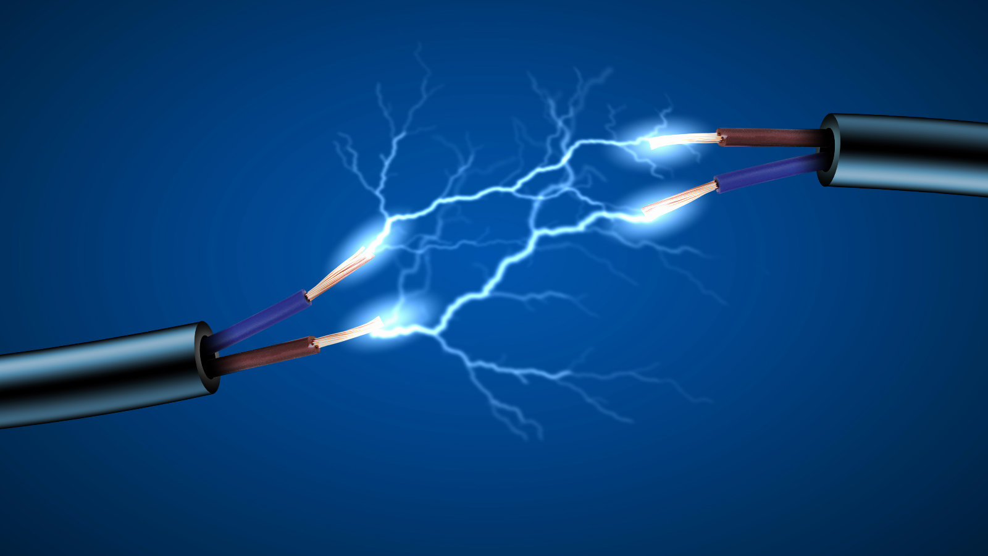

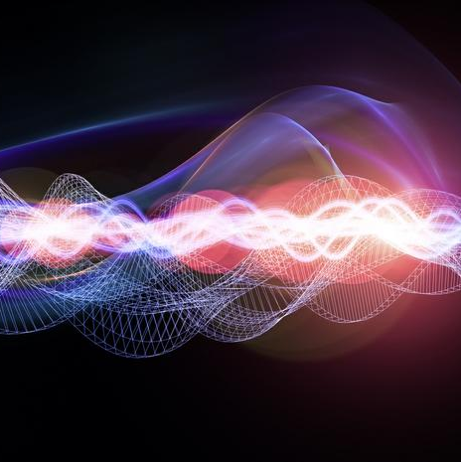
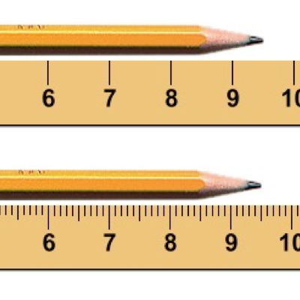
Measurements and their errors (page 10) 2 Particles and radiation (page 12) 3 Waves (page 17) 4 Mechanics and materials (page 21) 5 Electricity
Particles & Radiation
Electricity
Mechanics and Materials
Waves
Uncertainty and Measurements

